Slide 1
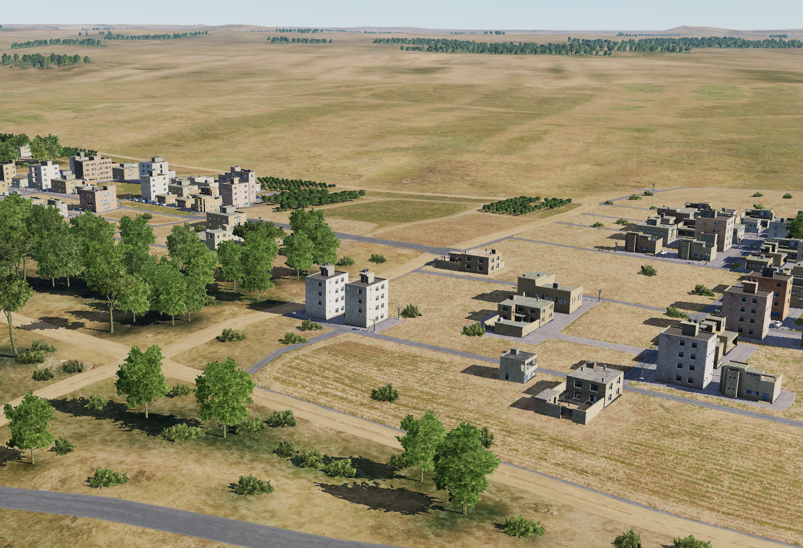
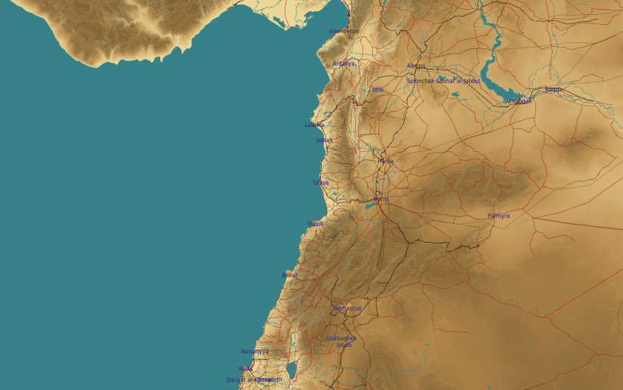
OPARTGT088 Syrian Intelligence office
N
88
1
2
DESCRIPTION OF THE DESIRED POINTS OF IMPACT WITH WPN TYPE:
OPARTGT088A – Southern Building
DPI 1 N36 14.690 E038 14.601/1053ft/(1000 Ibs bomb)
OPARTGT088B – Northern Building
DPI 2 N36 14.693 E03814.601/1053ft/(1000 Ibs bomb)
OPARTGT0088A/B – 4 storey buildings made of concrete slab supported by reinforced concrete base and pillars, flat poured roof, requires delayed fuzing.
Suggested fuzing solution on DPIs 1-2 – Contact
4
5
6
Collateral damage concerns to the east, south abd west within 25m.
7
8

